Slide 1
RPE Unit IV Ethics
9-4-21
V. Kannan

Slide 2
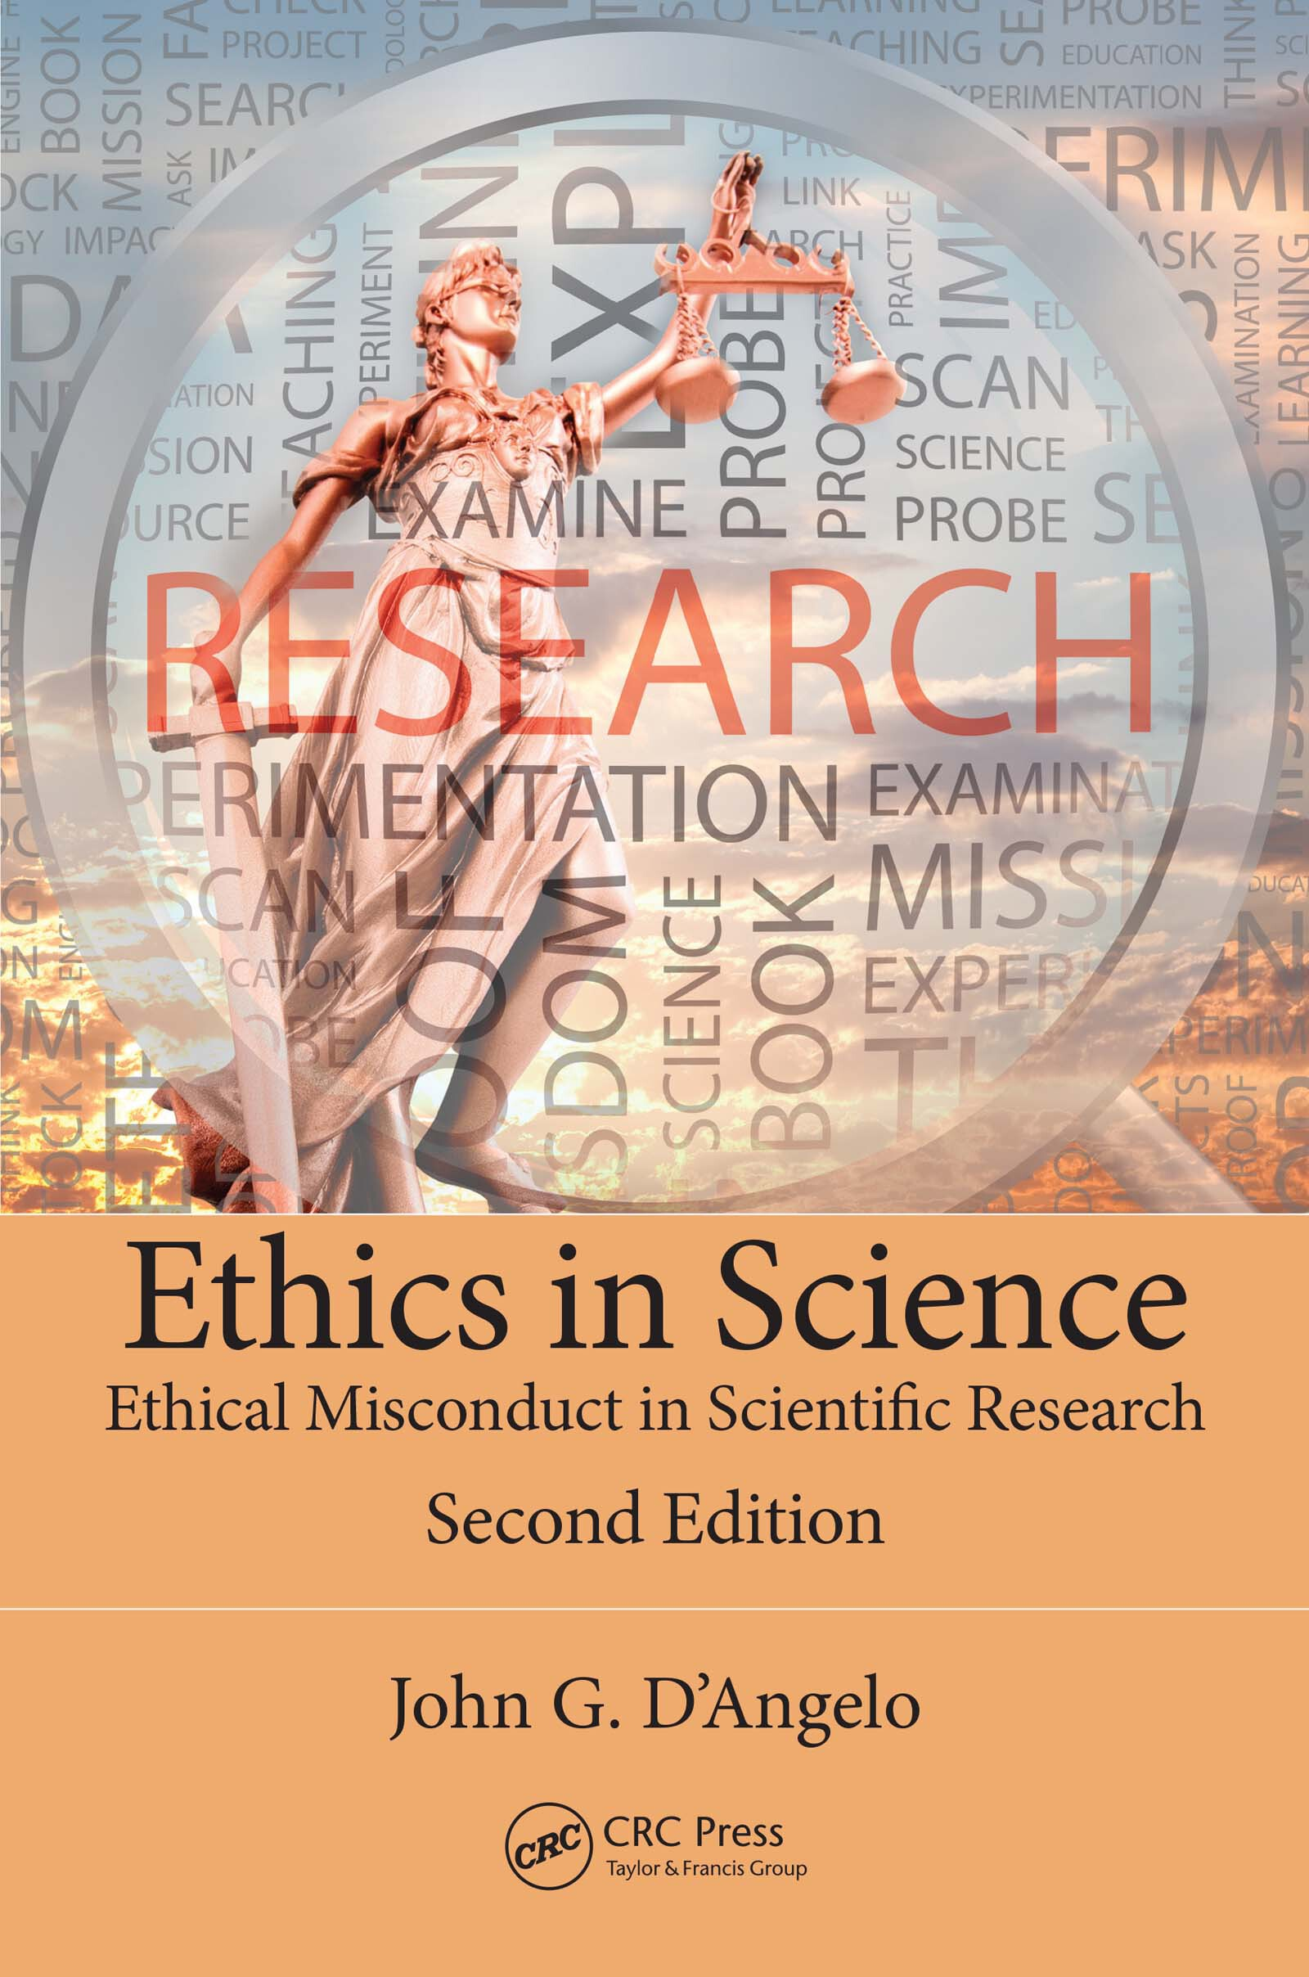
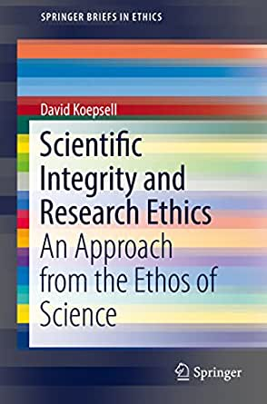
Books followed

Slide 3
10 types of research misconduct
Misappropriation of ideas
Plagiarism
Self-plagiarism
Claiming undeserved authorship
Misuse of research funds
Deceptive generation of preferred results
Falsification of data
Denial of credits to others.
Repeated publication of too similar results.
Mis-representation of others’ results.

Slide 4
1. Mis-appropriation of ideas
Good research thrives on fresh ideas.
Sometimes we have to share our ideas with others, when they are in a nascent stage.
For example when we write preliminary reports, or when we make announcements, or even during conference-presentations, we disclose new ideas.
A clever person can easily steal our ideas, refine them or reformulate them, and with a little effort, exploit that idea to one’s own benefit.
The saying that “education cannot be stolen” is only partially true.
This “stealth” is sometimes appreciated by others!

Slide 5
2. Plagiarism
Presenting some one else’s work as one’s own.
This is a gross ethical violation.
If the previous misconduct 1 is compared to “pick-pocket”, the present one (plagiarism) is like a “highway robbery”.
There are several levels of plagiarism, from a harmless one to a full-fledged one.
There have been instances of “full research papers” being republished by different authors.
Often, they get published again!

Slide 6
3. Self-plagiarism
How can one steal one’s own money?
There are instances when one generates new “papers” from his/her own old papers, with minimal changes here and there.
These authors suppress the fact that most of it is already known.
They want to earn multiple credits for a single achievement.
They do not consider this as too unethical.
Still, it is a breach of professional trust.

Slide 7
4. Claiming undeserved authorship
One should not claim a co-authorship in a paper, if one’s own contribution to that paper is negligible.
But it very often happens that the academic heads or the senior researchers insist on their names being added among the authors, even when they have marginally (or nil) contributed.
They are exploiting the system in their favour in an undue manner.
One should not agree to be credited with authorship, when one is really not.

Slide 8
5. Misuse of research funds
Does this come under Research ethics?
Yes.
The funds have to be used for the same purposes for which they are granted.
If they are used for related research (though not for the one for which they are granted), it is acceptable by the community of researchers, though not by the funding agency.
A serious misuse is when the funds are diverted to other purposes away from the present research.
Very often this kind of misuse happens to some extent.

Slide 9
6. Cooking up results
This can happen in two ways. One is this. Instead of “finding” the result, some researchers pre-decide the final result and accordingly, “set” their experiments. This is more common in social sciences than in sciences.
But this “deceptive generation of results as desired”, is occasionally resorted to in science subjects also, when the researcher is “conditioned” by his desire to be in conformity with other researchers.

Slide 10
7. Falsification of data
This is nowadays becoming more and more common.
The researcher falsifies the data, in order to arrive at the desired results.
This defeats the very purpose of doing research.
If the genuine data are kept without manipulation, then it is easy to find that the final results are different.
Therefore, a fraudster falsifies the data also.

Slide 11
8. Denial of credits to others
To other co-authors
To the previous workers in the same area.
To others who indirectly helped in this research.

